Slide 1
Transmissions from Planet Albany
Matt DeLaus, NYSSBA Governmental Relations Counsel
October 8, 2025

Slide 2
NYS Year in Review
Full funding of Foundation Aid
Universal School Meals
Increase to BOCES Salary Cap
Changes to Zero-Emission Bus Requirements
School Budget Legislation

Slide 3
Enacted Budget
$254.3 billion – “All Funds” Budget (+$11B or 4.5%)
$37.1 billion – State Aid for Schools (+$1.75B or 4.9%)
  Governor proposed $36.9 billion (+$1.69 billion or 4.8%)
Latest state budget in 15 years

Slide 4
School Aid
Formula-based school aid = $37.1 billion (+$1.75B or 4.9%)
  Foundation Aid increase - $1.43 billion (+5.7%)
    Includes guaranteed 2% minimum increase
  Expense-based aid increase - $321 million
    Full-funding of transportation aid, BOCES aid, etc.

Slide 5
Foundation Aid

Slide 6
Foundation Aid Formula
Updates and Adjustments to the Formula
  Replaces 2000 Census poverty data with the most recent Census Small Area Income and Poverty Estimates (SAIPE) data
  Replaces the usage of Free- and Reduced-Price Lunch (FRPL) data with ‘economically disadvantaged’ data
  Adjusts the state sharing ratio calculation, including boosting the maximum figure from .91 to .93
  Slightly increases the weighting for English language learner (ELL) students, from .50 to .53
  Adds a new regional cost index specific to Westchester County

Slide 7
Foundation Aid
Then Why Did My Foundation Aid Go Down???
In addition to some new minor formula adjustments, the enacted budget uses a February 2025 database, while the executive budget uses a November 2024 database
  Inflation data moves from an estimate to actual
  Updated district-submitted/specific data
The more ‘up-to-date’ February database can cause some variations in many state aid categories, including Foundation Aid
  Most of the time these variations are small, but there can be more meaningful increases/decreases for some districts
  With Foundation Aid, 360 districts remained unchanged,
  162 increased and 151 decreased

Slide 8
Foundation Aid

Slide 9
BOCES Aid and Special Services Aid
Increases the BOCES aidable salary cap to $60,000 over three-year period
Increases special services aid for non-component districts for CTE
  From $3,900 used to calculate aid to $4,100
  Expands the special services aid calculation to include 9th graders
  Begins with 2025-26 school year

Slide 10
BOCES Aidable Salary Cap

Slide 11
Civil Service and Staffing
Extends retiree earnings cap waiver for school districts and BOCES for an additional two years, until 2027
Extends civil service exam fee waiver for 2 years

Slide 12
Universal School Meals
Includes additional $160 million to fully reimburse for all meals served
Total annual funding amount - $340 million
Universal Free School Meals Program
  Requires all schools that participate in the National School Lunch and Breakfast Program to serve breakfast and lunch to all students

Slide 13
Smart Device Ban
Requires all school districts, BOCES and charter schools must adopt a policy by August 1, 2025
Policy will prohibit use of “internet-enabled devices” during the school day and on school grounds
Must retain method for parents or guardians to contact students
$13.5 million for implementation

Slide 14
Zero Emission Buses
Extends SED authority to grant district-by-district two-year waivers to the 2027 deadline
Expands one-time waiver to allowing for two waivers (48 months total)
  May consider infrastructure, availability, funding, “other factors outside control of the district,” etc.

Slide 15
Zero Emission Buses
Requirement that bus dealers provide an independent third-party battery range estimate
Up to $100 million in new funding to support the purchase of zero-emission school buses and supporting infrastructure

Slide 16
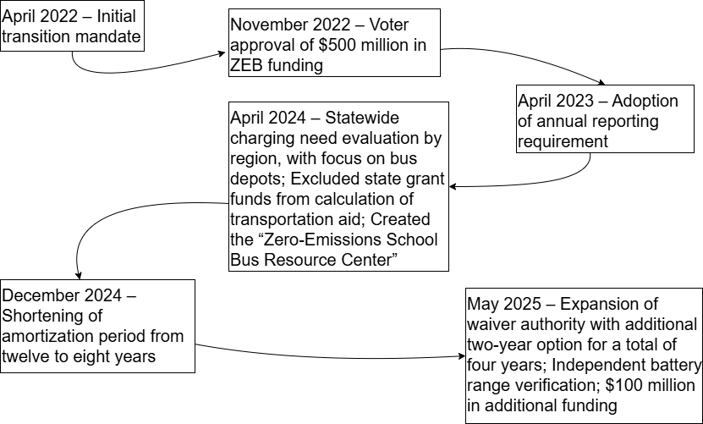
Zero Emission Bus Changes Since 2022

Slide 17
Additional Items
Maintains level Pre-K funding
Extends Medicaid managed care program carve out for SBHCs until April 1, 2026
Rejects making the CSE placement cost-shift permanent
Rejects the freeze of the school aid database and capping aid payments
Directs SED to adopt a statewide policy for dual enrollment program participation

Slide 18
Additional Items
Adjusts the charter transitional aid formula, boosting aid for districts with high charter saturation
Modifies test standards for substantial equivalency compliance for religious non-public schools following “phase-in” until 2032-33
Budget Reduction “Super Power” to allow governor to make mid-year cuts

Slide 19
What Was Left Out?
Addressing the $300 million in Prior Year Aid claims owed to districts by the state
Permanent increase to retiree earnings cap
Requiring school representation on all Industrial Development Agency (IDA) boards

Slide 20
School Election Reforms
Provide flexibility for date of annual organizational meeting
Create process for Commissioner to declare additional day of voting where original budget vote was disrupted by a disaster
Update absentee ballot application

Slide 21
Year to Come
Pension Reform
Mandatory Recess
Tax Credit/Vouchers
Zero-Emission Buses
AI
Holidays/Schedule
Student Discipline
Shared Services
CVA
And more…it’s an election year!

Slide 22
Reconciliation – “One Big Beautiful Bill”
Expedited consideration of certain spending, revenue, and debt limit legislation
  Not subject to Senate filibuster
Signed into law on July 4
Lifts SALT Deduction Cap to $40,000
Tuition tax credits/vouchers
Cut Medicaid Benefits
Cut SNAP
Little/no direct fiscal impact on schools

Slide 23
Effects of Reconciliation (New York)
1.5 million New Yorkers to lose Medicaid
  Medicaid billable services pursuant to IEPs
  School meal reimbursements
  School-based health centers
Loss of SNAP
  School meal reimbursements
Potential State funding gaps over $15 billion
  Authority granted for NYS Budget Director to withhold
  appropriated payments in FY 26 if a general fund imbalance
  of $2 billion or more is projected or occurs

Slide 24
Federal Funding Freeze
On June 30, states received notice that federal education funds ($6+ billion) due to be released on July 1 were ‘under review’ (withheld/frozen) to ensure “taxpayer resources are spent in accordance with the President’s priorities and the Department’s statutory responsibilities.”
  On July 16, 10 GOP Senators send letter to OMB calling for release of the funds ($6+ billion)
  On July 25, Trump administration announces release
  of the funds

Slide 25
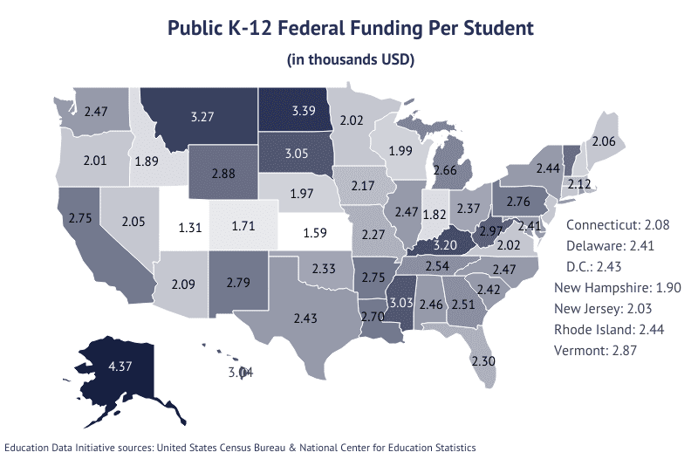
Federal Funding Per Pupil, by State

Slide 26
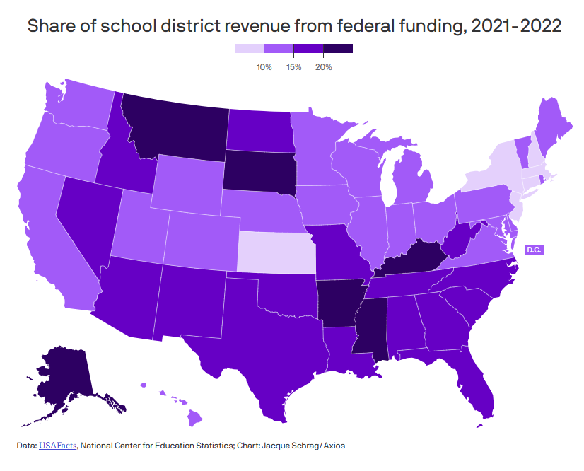
Federal Funding Share, by State

Slide 27
What About NYSED?

Slide 28
FY 2026 Proposals
Administration
Cuts $12.4B from ED
  $6B K-12
Level Title I-A funding
Block grants most of IDEA
Block grants ($4B cut) other programs
Eliminates Title I-C, Title III, Full-Service Community Schools, etc.
House
Cuts $12B from ED
Cuts Title I-A by $3.8B
Eliminates Title I Parts C and D, Title II and Title III
Slight increases in for Title IV Part A and Impact Aid
Rescinds $2.6B in Title I and Title II funds
Senate
Modest increases to
Title I-A and IDEA
Generally level funding elsewhere
Adds language to require funding goes out by July 1 and prevents transfer of programs to another Department

Slide 29
Shutdown – General
Federal government shut down as of October 1
  A short-term 7 week “CR” repeatedly did not pass in the Senate, after previously passing the House
  Essential employees and essential services are still running
    But many of those employees will not be paid
  Some essential benefits, including social security, will continue to be paid
  ~750,000 federal employees furloughed

Slide 30
Shutdown – Education
Most main federal education funding streams will be unaffected for the time being
  Title funds and IDEA are generally forward-funded
  USDA has indicated that they have 2-3 months worth of school meal funding
Non-forward funded and other discretionary programs have likely stopped flowing
  Inc. Impact Aid and Head Start
Other actions either stop or will be meaningfully slowed down
  Ex. new application reviews, civil rights investigations/enforcement, USDOE technical assistance
Risk for financial disruption increases the longer
the shutdown goes on

Slide 31
Past Federal Government Shutdowns
2018-19 – 35 days
2018 – 3 days
2013 – 13 days
1995-1996 – 21
1995 – 5 days
1990 – 3 days
1986 – <1 day
1984 – <1 day
1981 – 1 day
1980 – 1 day

Slide 32
What Else?
E-Rate
Universal Service Fund
Freezes/Withholdings?
Rescission?
Norms?
Notes:
Rescission of previously appropriated funds
Requires simple majority in the Senate
Could education funding be rescinded?
Rescissions without Congressional approval

Slide 33
Questions?
Matt DeLaus, Governmental Relations Counsel
  matt.delaus@nyssba.org

